Slide 1

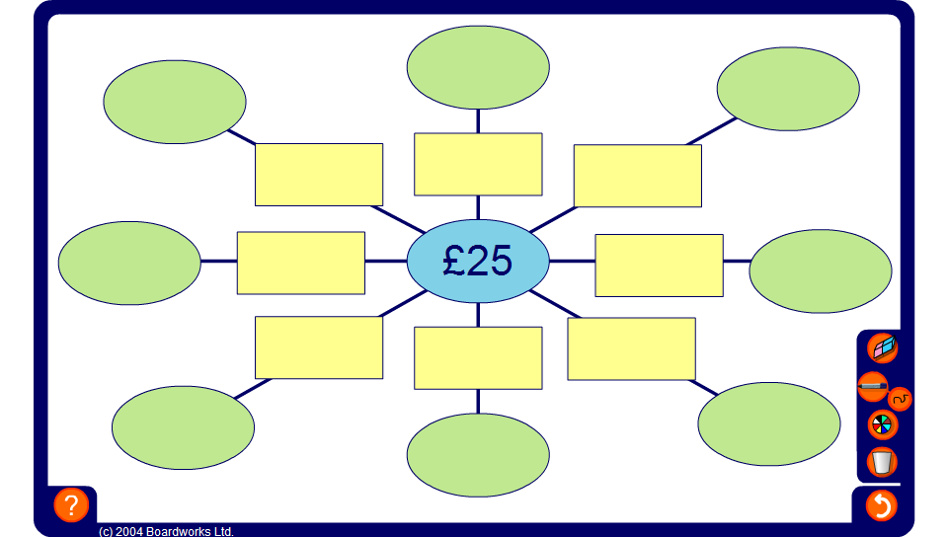


Spider diagram
Notes:
Start by working out the percentage at the top, 1% of the value in the centre of the spider diagram.
Work around the spider diagram in a clockwise direction to find 10%, 25% and 50% of the central value. The remaining four percentages can be calculated mentally by adding, subtracting or multiplying the amounts already found.
Discuss any mental strategies used each time.
Make the activity more challenging by changing the order or revealing the proportion and asking what percentage of the central amount it represents.

